Slide 1
Post-Quantum Security of Fiat-Shamir
Dominique Unruh
University of Tartu

Slide 2
Fiat-Shamir (overview)
Non-interactive proof system:
Zero-knowledge proof of knowledge
Signature scheme (Signer proves knowledge of sk)
Quantum secure?
Prover
$$com,H\left(com\right),resp$$
Verifier
statement
witness
statement
Verifier learns “nothing”
Prover must know witness

Slide 3
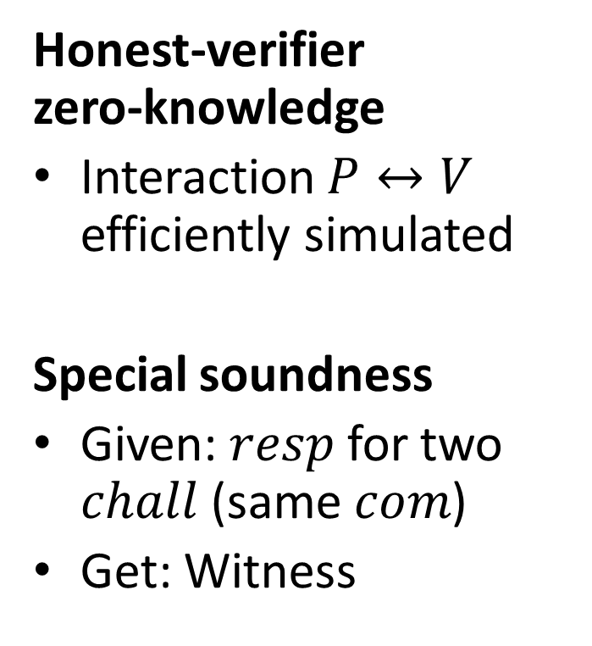
Understanding FS: Sigma protocols
Interactive proof system
Honest-verifier zero-knowledge
Interaction $P↔V$ efficiently simulated
Special soundness
Given: $resp$ for two $chall$ (same $com$)
Get: Witness
P
V
commitment
challenge
response

Slide 4
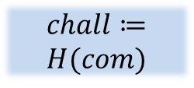
Understanding FS: The construction
Prover
Verifier
Prover sends simulated sigma-proto interaction
→ Soundness of sigma-protocol carries over
P
$$com$$
V
$$chall≔ \\ H(com)$$
$$com,chall,resp$$
$$chall$$
$$resp$$

Slide 5
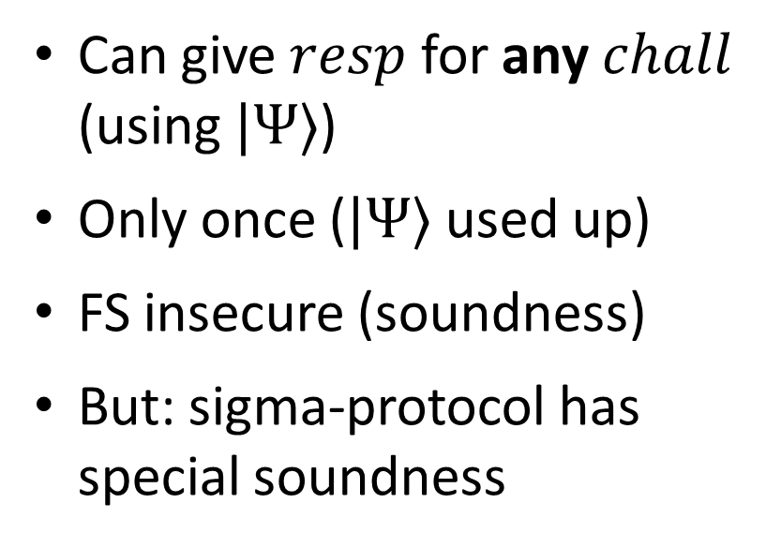
Breaking FS soundness (quantum)
Artificial sigma-protocol [Ambainis,Rosmanis,U14] (relative to specific oracles)
P
Can give $resp$ for any $chall$ (using $|Ψ〉$)
Only once ($|Ψ〉$ used up)
FS insecure (soundness)
But: sigma-protocol has special soundness
$$comm$$
$$|Ψ〉$$
$$chall$$
$$resp$$

Slide 6
Breaking FS soundness (quantum)
FS not secure in general
For quantum attackers
Relative to specific oracles
Ways out:
Non-relativizing proofs? Doubtful.
Other protocols? Yes.
Extra conditions on sigma-protocol? This talk.
[U15] [Dagdelen, Fischlin,Gagliardoni13]

Slide 7
Main result
Sigma protocol
Fiat-Shamir
Stronger than classical
Statistical soundness
Reduction to quantum search
Simulation soundness
Weaker than classical
Honest verifier ZK
Adaptive RO reprogramming
Zero knowledge
Unpredictable commitments
Complete
Complete

Slide 8
Soundness proof
Sigma protocol
Def: $chall$ is “promising” if $∃ resp$
P
V
$$com$$
statistical soundness$⟹$ For any $com$, few promising $chall$
$$chall$$
$$resp$$
Hard to find: $com$ with $H(x,com)$ promising
Fiat-Shamir
P
$$com,H\left(x,com\right),resp$$
V
Hard to break Fiat-Shamir soundness: Finding valid $com,H\left(x,com\right),resp$

Slide 9
What about signatures?
Quantum
Classical approach:
Sigma protocol
Fiat-Shamir (as proof)
Statistical
Special soundness
Simulation sound extractability
✔
?
Fiat-Shamir (as signature)
Unforgeability
Honest verifier ZK
Zero knowledge
Dual-mode
Hard instances
Hard to guess $sk$ from $pk$
$pk$ indistinguishable from $pk$ without $sk$

Slide 10
Open problems
Suitable sigma protocols [Kiltz,Lyubashevsky,Schaffner]?
Stronger guarantees: Extractability?
Weaker assms: Computational soundness?
Tightness of reductions

Slide 11
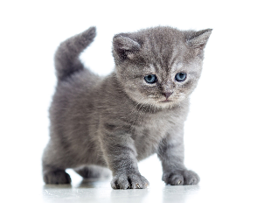
I thank you for your attention
This research was supported by European Social Fund’s Doctoral Studies and Internationalisation Programme DoRa

